Slide 1
Therac-25 Case
Computingcases.org
Safeware

Slide 2
In this case…
you will practice decision-making from the participatory standpoint
learn how to make decisions in the face of uncertainty
  Uncertain whether the patient complaints indicate radiation overdoes
  Uncertain, if there is overdose, whether the cause if machine failure or operator error or something else.
these decisions involve risk (probability of harm) and you will learn about ethical issues associated with safety and risk

Slide 3
The Machine: Therac-25
Medical linear accelerators (linacs)
Earlier Models: Therac-6 and 20
Therac-25
  First prototype in 1976
  Marketed in late 1982

Slide 4
What it does
Leveson: “Medical linear accelerators accelerate electrons to create high-energy beams that can destroy tumors with minimal impact on surrounding healthy tissue” 515
Shallow tissue is treated with accelerated electrons
  “the scanning magnets [were] placed in the way of the beam” “The spread of the beam (and thus its power) could be controlled by the magnetic fields generated by these magnets” (Huff/Brown)
Deeper tissue is treated with X-ray photons
  Huff: “The X-ray beam is then “flattened” by a device below the foil, and the ex-ray beam of an appropriate intensity is then directed to the patient.” (requires foil and flattener)
Beams kill (or retard the growth of) the cancerous tissue

Slide 5
Therac-25 Hardware Features (Leveson 516-517)
Double Pass Electron Accelerator
  “needs much less space to develop comparable energy levels”
  “folds the long physical mechanism required to accelerate the electrons”
Dual Mode
  Turntable allows aligning equipment/accessories in different ways
  One alignment produces X-rays
  Another alignment produces electrons
  Third alignment (field light position) is used for targeting machine
More computer control
  Speeds up alignment of turntable (equipment to accessories)
  Speeds up data entry (patient/dose/data)
  More patients/more time per patient

Slide 6
Therac-25: Hardware controls to software controls
Machine functions that software had to monitor
  Monitoring the machine status
  Placement of turntable
  Strength and shape of beam
  Operation of bending and scanning magnets
  Setting the machine up for the specified treatment
  Turning the beam on
  Turning the beam off (after treatment, on operator command, or if a malfunction is detected)
(Huff, 2005)

Slide 7
Two features of Therac-25 to save time
Retry Facility
  Controls pause treatment if there is a minor discrepancy between machine setting and dose entered
  Up to 5 retries are allowed before machine completely shuts itself down (in event of small discrepancies)
Shut Down Facility
  If there is a major discrepancy, then the machine shuts itself down
  To restart, the operator must reenter all the treatment parameters
  Some operators used jumper cables to bypass this shutdown feature

Slide 8
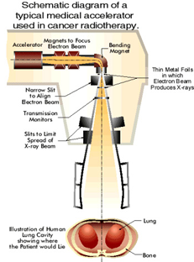

Slide 9
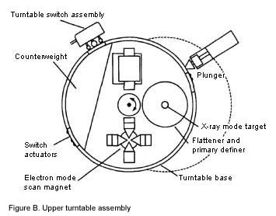

Slide 10
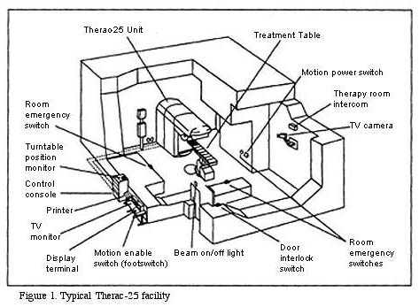

Slide 11
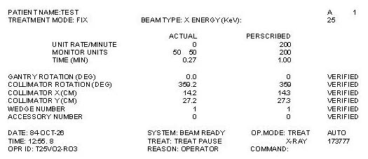

Slide 12
Software Components
Stored data
  Calibration parameters for accelerator setup
  Patient treatment data
Scheduler
  Controls sequencing of all noninterrupt events and coordinates all concurrent processes
Set of critical and noncritical tasks
  Critical: treatment monitor, servo task (gun emission, dose rate, machine motions), housekeeper task (system status, interlocks, displays messages)
  Noncritical: checksum, treatment console keyboard processor, treatment console screen processor, service keyboard processor, snapshot, hand control processor, calibration processor
Interrupt services

Slide 13
Programming Issues
Real-time software
  “interacts with the world on the world’s schedule, not the software’s.”
Software is required to monitor several activities simultaneously in real time
Interaction with operator
  Monitoring input and editing changes from an operator
  Updating the screen to show the current status of machine
  Printing in response to an operator commands

Slide 14
Participant Profile: Patients
Receive radiation therapy
Shallow tissue is treated with accelerated electrons
Deeper tissue is treated with X-ray photons
Interest
  Health and Well Being
  Informed Consent
    Conditions required for consent
    Belmont Report:
      Information
      Comprehension
      Voluntariness

Slide 15
Participant Profiles: Hospitals and Cancer Treatment Centers
Hospitals
  Kennestone facility in Marietta, GA
  (ETCC) East Texas Cancer Center, Tyler, TX (2)
  Hamilton, Ontario Hospital
  Yakima Valley Memorial Hospital (2)
Interest
  Maintain good reputation; promote patient values of health and well being; maintain financial solvency
Role
  Provide treatment options for patients; staff hospitals with doctors and nurses; equip with adequate medical technology

Slide 16
Participant Profiles: Users
User Groups (Operators)
  Put out user group newsletters
Hospital Physicists
  Tim Still (Physicist at Kennestone)
    Eight problems with Therac-25
    Poor screen-refresh subroutines
    “Is programming safety relying too much on the software interlock routines?” *
  Fritz Hager (Physicist at ETCC)
    Consulted with AECL on suspected overdoses
    Helped operator reconstruct sequence that produced race condition
Interest: job, reputation, professional dignity and integrity
Role: maintain treatment machines; supervise operators; respond to patient complaints
    * Leveson, p. 539

Slide 17
Operator Perspective
The newest machine has replaced hardware safety controls with software controls.
  But operators find this deskilling objectionable
Operator activates machine from another room. But audio and video systems do not work yet they must continue to treat patients
Software controls shorten time required for each treatment.
  Operators feel pressured to treat more patients
Error messages provided by Therac-25 monitor are not helpful to operators
  Machine pauses treatment but does not indicate reason why

Slide 18
Interview with Therac Unit Operator
Did not consider possibility of software bugs
Appreciated added speed of operation (more patients, more time with patient)
Unclear error messages
No industry-wide standards on whether, how, and how many times operators could override error messages

Slide 19
Interview (Cont.)
Lack of industry-wide certification of radiation unit operators
  ARRT provides test and licensing procedure
  But many hospitals hire non-ARRT certified operators
Operators pressured by many hospital administrators to push through a large number of patients
Manufacturers charge large fees for…
  Operator training sessions
  Software upgrades
  Machine maintenance contracts

Slide 20
Participant Profile: Manufacturers
Interest: reputation, financial gain
Role: Design, tested, prepared for approval, manufactured, sold Therac units
Atomic Energy of Canada Limited (AECL)
  Quality Assurance Manager
  Home office engineer
  Local (Tyler) engineer
  Software Programmer (licensed?)
CGR (France)
  Dropped out after production of 20 unit in 1981

Slide 21
Participant Profile: Manufacturer’s Engineers
AECL engineers
  Designed and tested new units
  Not responsible for maintenance (This was performed by hospital physicists)
  Sent to investigate complaints about units
  Quality Assurance Manager
  Software Programmer
Are they responsible for collecting information on the use-history of the machines they designed?

Slide 22
Testing the Machine for Safety
1983—Fault Tree Analysis
Specify hazards
Specify causal sequences to produce hazards
Software not included
  Software added onto existing software used in prior units
  Since these did not fail, assumed software was not subject to failure

Slide 23
Participant Profiles: Regulatory Agencies
FDA (Food and Drug Administration)
CRPB (Canadian Radiation Protection Bureau)
  Gordon Symonds head of advanced X-ray Systems
  Interest (Maintaining integrity in public eye)
  Role (Regulate new products for safety)

Slide 24
FDA Pre-Market Approval
Class I
  “general controls provide reasonable reassurance of safety and effectiveness””
Class II
  “require performance standards in addition to general controls”
Class III
  Undergo premarket approval as well as comply with general controls
Used earlier Therac models to show “pre-market equivalence”
  But this covered over three key changes:
    removal of hardware safety controls,
    delegation of safety from hardware to software,
    No testing of additional programming for Therac-25 layered on programming for 6 and 20 units

Slide 25
FDA couldn’t recall defective products
Ask for information from a manufacturer
Require a report from the manufacturer
Declare a product defective and require a corrective action plan (CAP)
Publicly recommend that routine use of the system on patients be discontinued
Publicly recommend a recall

Slide 26
Roles not assigned to participants
Obligations that following from the social or professional role one occupies
  Who is responsible for testing the software and hardware of the Therac-25 unit? (Standards of due or reasonable care?)
  Who is responsible for monitoring the operating history of these machines and collecting and coordinating possible complaints?
    (Designers? Regulatory Agencies?)
  Who is responsible for regulating these machines and other devices?
  Who is responsible for teaching operators how to use machines and maintenance?
    Expensive AECL training programs. Limits of operator manuals
  How can machines be operated in an efficient way without sacrificing patient health, safety, and well being?

Slide 27
Chronology
Modified from Computing Cases
Chronology to the point where Hager has to make a decision.
Chronology picked up at end of presentation.

Slide 28
Date | Event
Early 1970’s | AECL and a French Company (CGR) collaborate to build Medical Linear Accelerators (linacs), Therac 6 and 20.
1976 | AECL develops the revolutionary “double pass” accelerator the basis of theTherac-25 model
1981 | AECL and CGR end working relationship.
March 1983 | AECL performs a safety analysis of Therac-25, excluding analysis of software. (Software assumed safer than hardware so safety functions delegated to software and hardware controls removed)
July 29, 1983 | Canadian Consulate General announces the introduction of the new Therac-25 machine
December 1984 | Marietta Georgia, Kennestone Reginal Oncology Center implements newT-25 unit

Slide 29
Date | Event
June 3, 1985 | Marietta Georgia, Kennestone—Possible patient overdosed. Tim Still, hospital physicist calls AECL (Is overdose possible? AECL informs that it is not)
July 26, 1985 | Hamilton, Ontario--possible patient overdose. AECL is informed and sends service engineer to investigate. No coordination between Georgia and Ontario
Nov 3, 1985 | Hamilton patient dies of cancer. But burn received in treatment would have eventually required hip replacement.
Nov 6, 1985 | Letter from CRPB to AECL requesting hardware interlocks and software changes. Letter also requested automatic treatment termination in event of malfunction with no option to proceed with single keystroke.
Nov 18, 1985 | Kennestone (possible) overdose victim files suit against AECL and Kennestone. AECL informed officially of lawsuit
Dec 1985 | Yakima Hospital (Washington) patient develops erythema on hip after one of treatments

Slide 30
Date | Event
Jan 31, 1986 | Yakima staff sends letter to AECL and speaks with AECL technical support advisor. Still no coordination between different hospitals
Feb 24, 1986 | AECL technical support supervisor sends written response to Yakima claiming that T-25 unit not responsible for patient injuries.
March 21-22, 1986 | Patient at East Texas Cancer Center (Tyler) receives possible overdose. Fritz Hager calls AECL and arranges for Randy Rhodes and Dave Nott to test T-25. Nothing found.
April 7 | T-25 put back into operation after ETCC finds no electrical problem
April 11 | Second possible overdose at ETCC. Operator reproduces Malfunction 54. Hager informs AECL of results
April 14 | AECL files report with FDA. Sends letter to T-25 users with suggestions including removal of up-arrow editing key and to cover contact with electrical tape

Slide 31
Sources
Nancy G. Leveson, Safeware: System Safety and Computers, New York: Addison-Wesley Publishing Company, 515-553
Nancy G. Leveson & Clark S. Turner, “An Investigation of the Therac-25 Accidents,” IEEE Computer, 26(7): 18-41, July 1993
www.computingcases.org (materials on case including interviews and supporting documents)
Sara Baase, A Gift of Fire: Social, Legal, and Ethical Issues in Computing, Upper Saddle River, NJ: Prentice-Hall, 125-129
Chuck Huff, Good Computing: A Virtue Approach to Computer Ethics, Draft for course CS-263. June 2005
Chuck Huff and Richard Brown. “Integrating Ethics into a Computing Curriculum: A Case Study of the Therac-25”
  Available at www.computingcases.org (http://computingcases.org/case_materials/therac/supporting_docs/Huff.Brown.pdf) Accessed Nov 10, 2010

